Slide 1
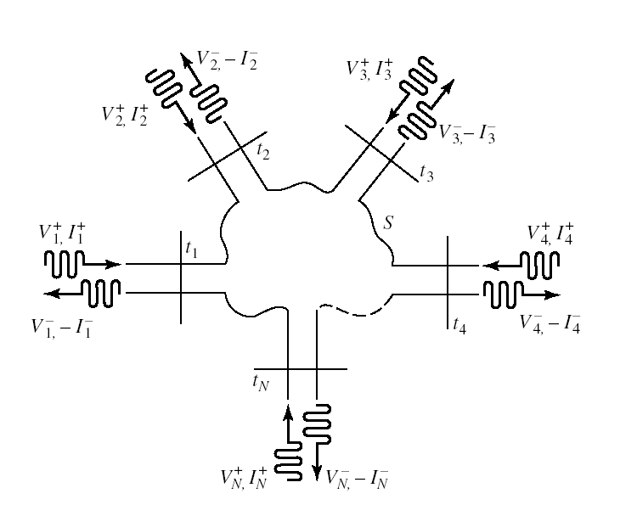
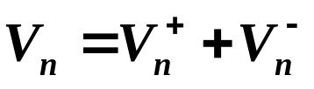
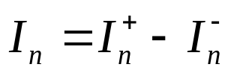
5.2 Impedance and Admittance matrices

Slide 2
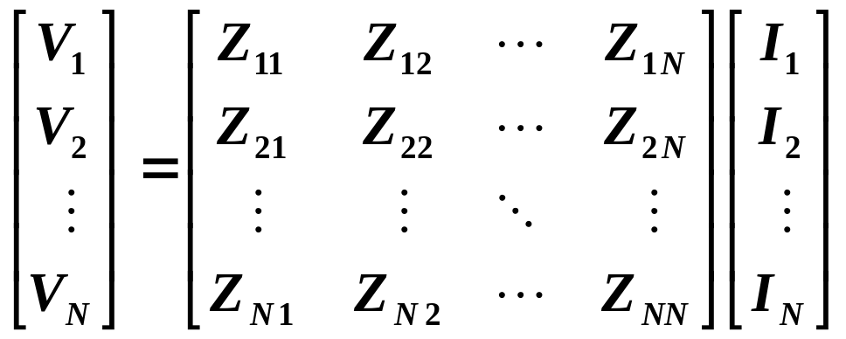

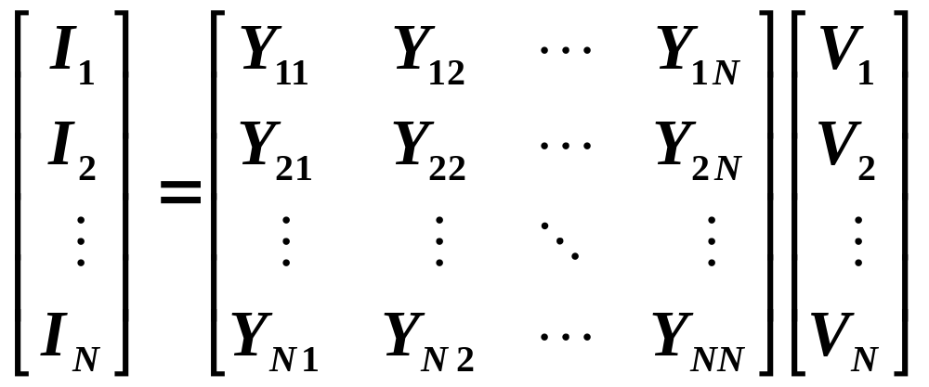


5.2 Impedance and Admittance matrices
Impedance Matrix [Z]
Admittance Matrix [Y]

Slide 3
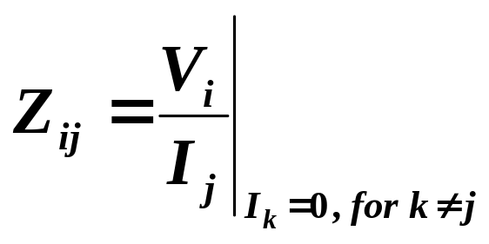
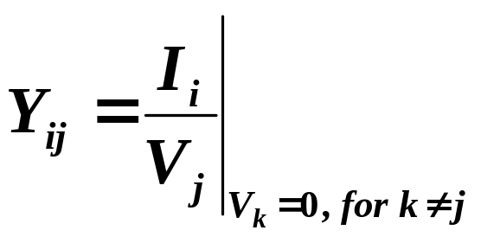
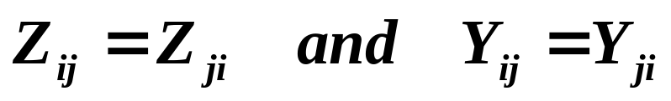
5.2 Impedance and Admittance matrices
Z_{ij} is the transfer impedance between i and j when all other ports are open-circuited. (Driving port j)
Y_{ij} is the transfer impedance between i and j when all other ports are short-circuited. (Driving port j)
If the network is reciprocal,
If the network is lossless,
all the Zij or Yij element are purely imaginary

Slide 4
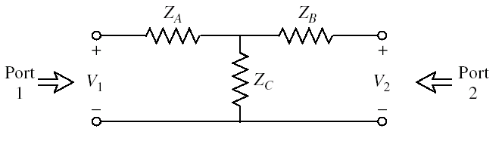
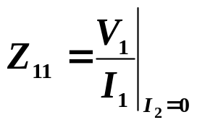


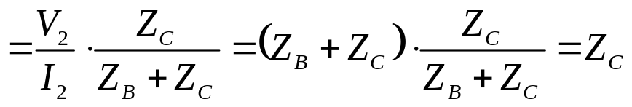
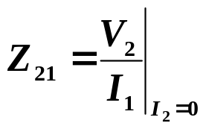
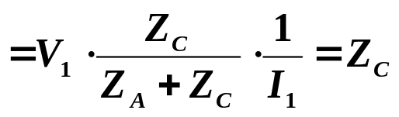



5.2 Impedance and Admittance matrices
Example: Evaluation of impedance parameters
Find the Z parameters of the two-port T-network

Slide 5
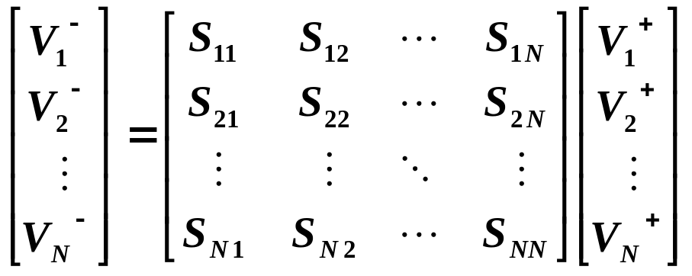
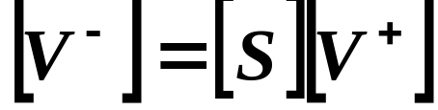
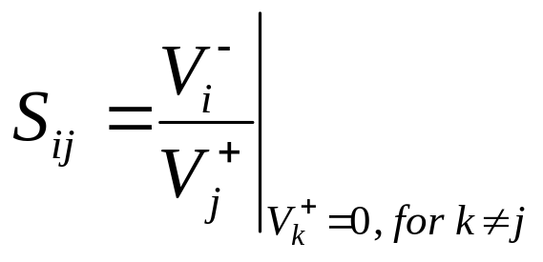
5.3 The Scattering Matrix
S_{ii} is the reflection coefficient seen looking into port i when all other ports are terminated in matched loads;
S_{ij} is the transmission coefficient from port j to port i when all other ports are terminated in matched loads

Slide 6
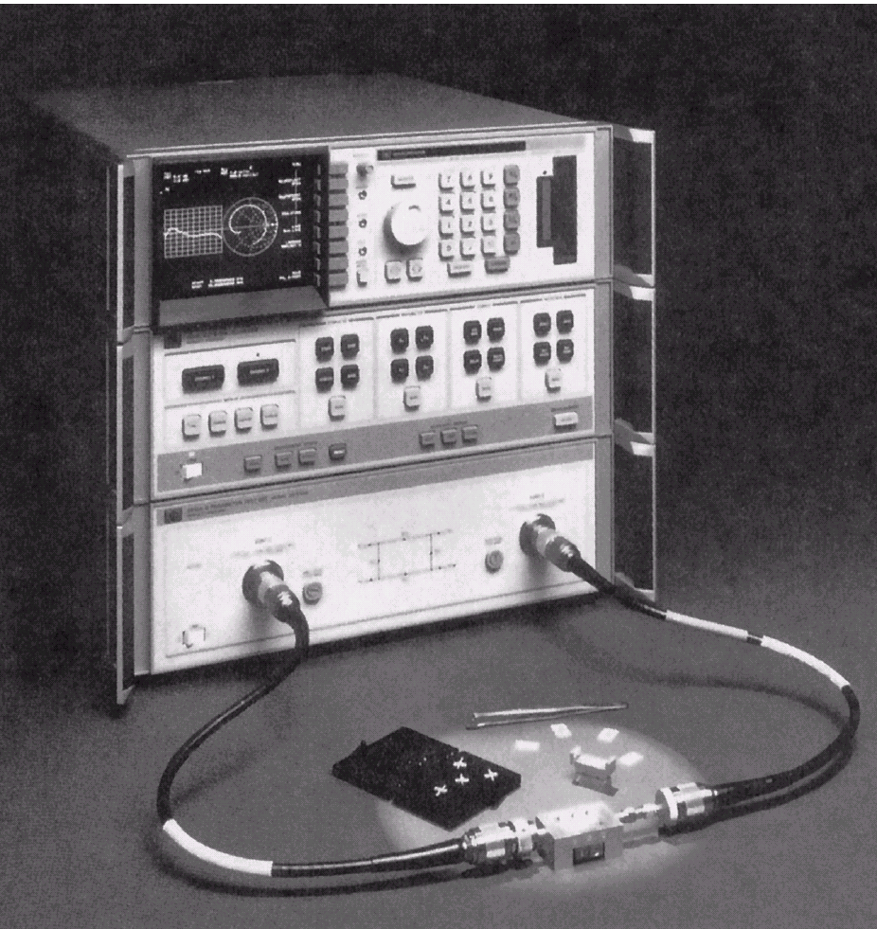
5.3 The Scattering Matrix
A photograph of the Hewlett-Packard HP8510B Network Analyzer. This test instrument is used to measure the scattering parameters (magnitude and phase) of a one- or two-port microwave network from 0.05 GHz to 26.5 GHz. Built-in microprocessors provide error correction, a high degree of accuracy, and a wide choice of display formats. This analyzer can also perform a fast Fourier transform of the frequency domain data to provide a time domain response of the network under test.
Network Analyzer

Slide 7
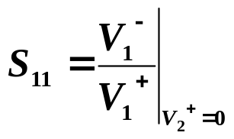
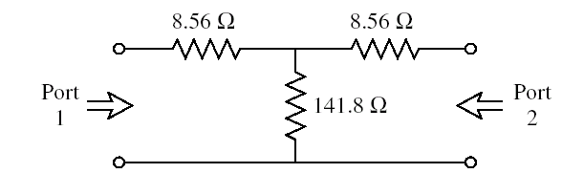
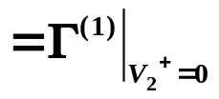
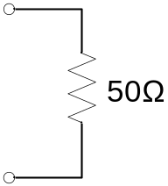
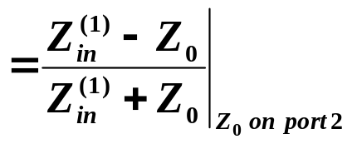

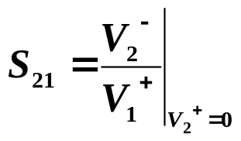


5.3 The Scattering Matrix
Example: Evaluation of scattering parameters
Find the S parameters of the matched 3dB attenuator with Z₀= 50Ω
Because of the symmetry of the circuit, S₂₂=0

Slide 8

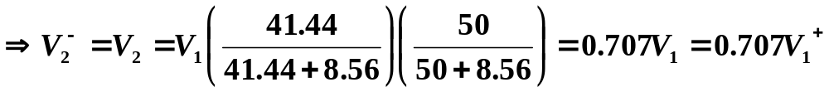
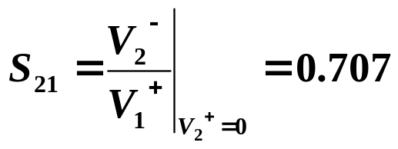
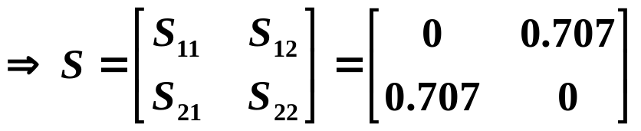

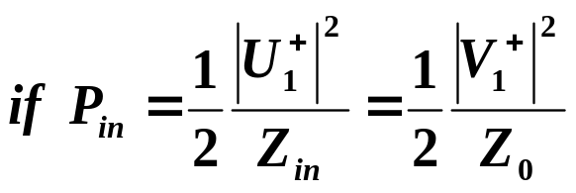
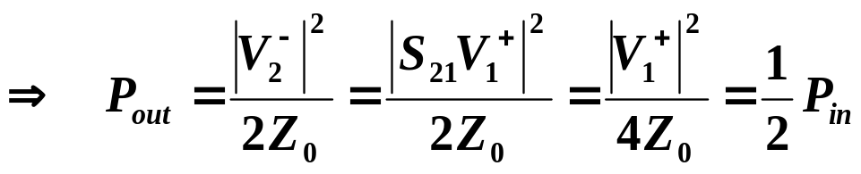
5.3 The Scattering Matrix
3dB attenuator

Slide 9
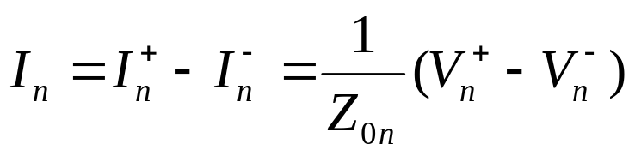
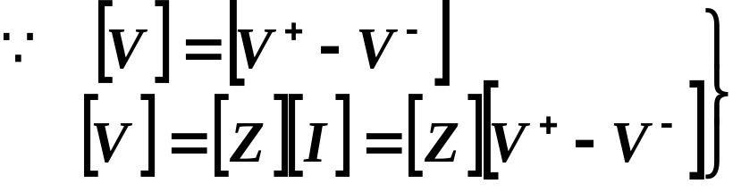

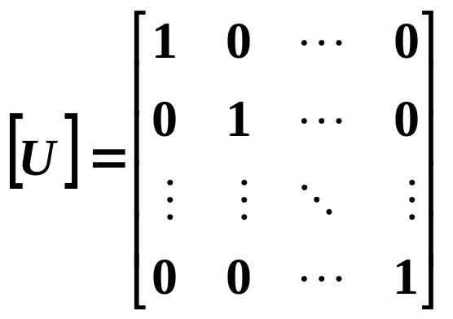

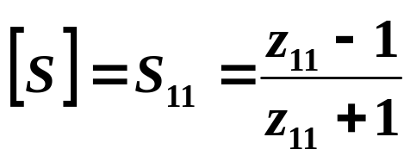
5.3 The Scattering Matrix
S matrix ←→ Z/Y matrix
Assume that the Zon of all the ports are identical. Set Zon=1
[U] is the unit, or identity matrix
For a one-port network:

Slide 10



5.3 The Scattering Matrix

Slide 11
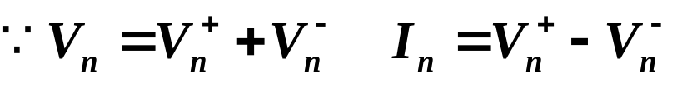



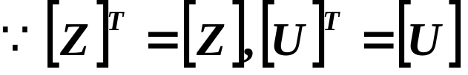


5.3 The Scattering Matrix
Special Properties of S matrix for Reciprocal Networks and Lossless Networks
For reciprocal network

Slide 12
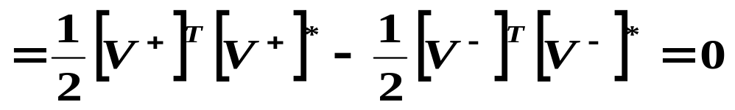
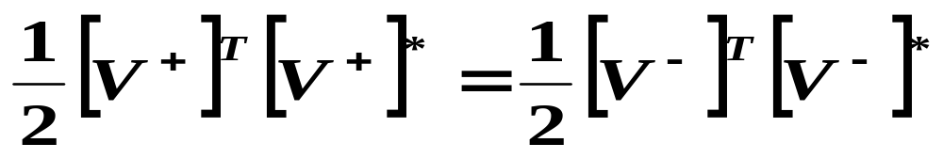
5.3 The Scattering Matrix——Reciprocal Networks and Lossless Networks
For lossless network
If the network is lossless, then no real power can be delivered to the network, thus, if the Z0 of all the ports are identical and assumed to be unity,
For a lossless junction,

Slide 13
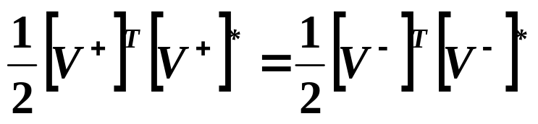

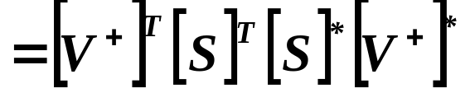
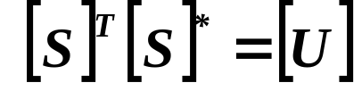

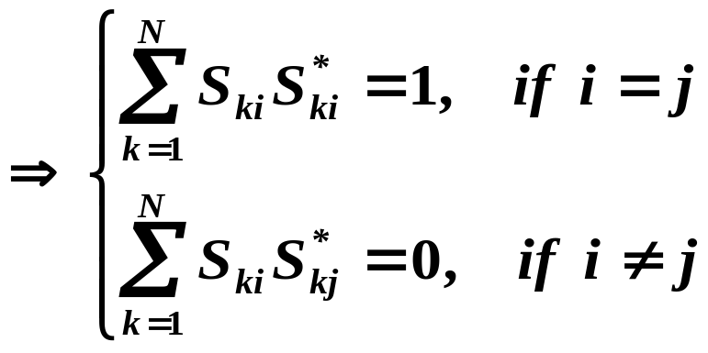
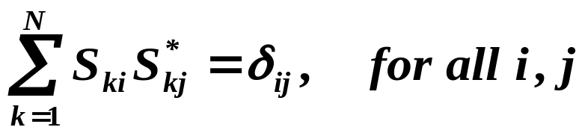
5.3 The Scattering Matrix——Reciprocal Networks and Lossless Networks
For a lossless junction,
So that, for nonzero [V⁺],
It is called a unitary matrix

Slide 14
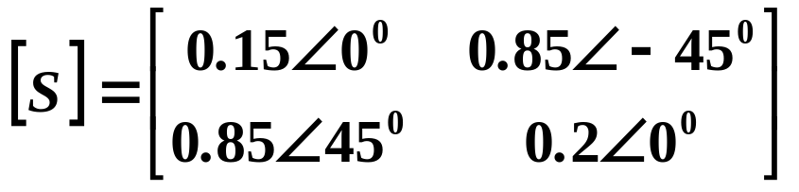
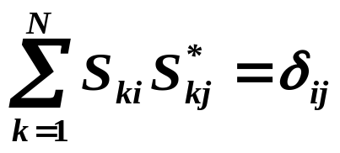
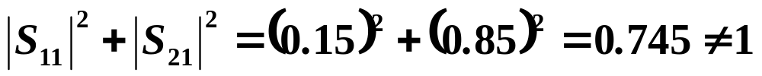

5.3 The Scattering Matrix
Example: application of scattering parameters
A two-port network with
Determine if the network is reciprocal, and lossless. If port 2 is terminated with a matched load, what is the return loss seen at port 1? If port2 is terminated with a short circuit, what is the return loss seen at port1?
Solution
Since [S] is not symmetric, → the network is not reciprocal
to be lossless, the S parameters must satisfy
→ not lossless
when port2 is terminated with a matched load,

Slide 15
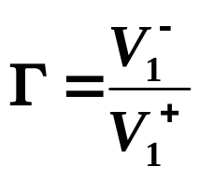
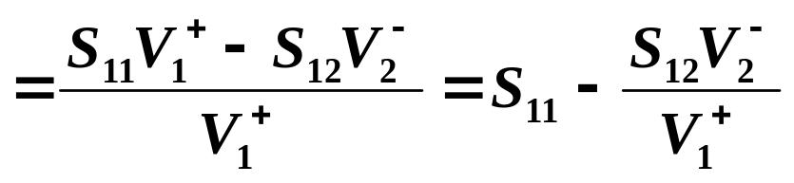
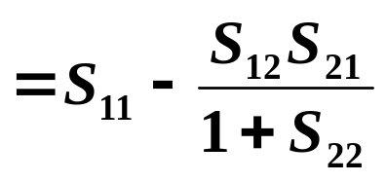
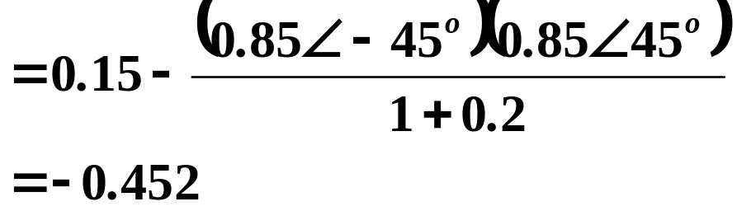
5.3 The Scattering Matrix——Example：application of S matrix
when port2 is terminated with a short circuit, the reflection coefficient seen at port1:

Slide 16
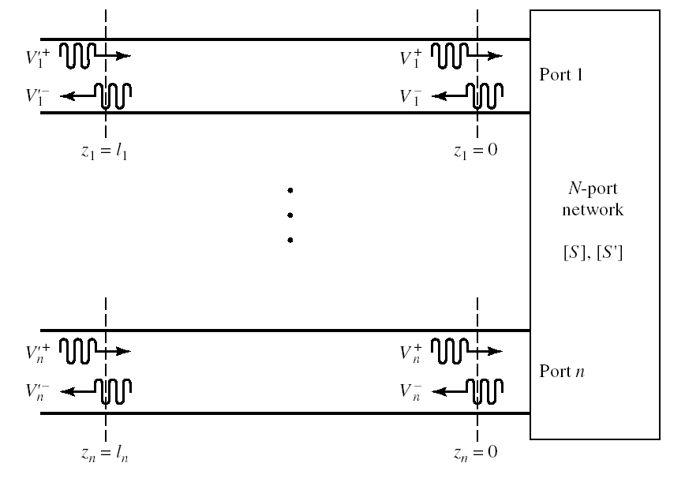
5.3 The Scattering Matrix
A shift in Reference planes

Slide 17
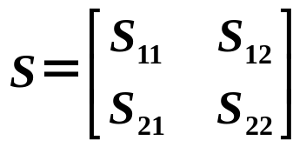


5.3 The Scattering Matrix——A shift in Reference planes
For a two-port network
If reference plane are T₁ and T₂，
Consider a new set of reference planes at T₁’ and T₂’

Slide 18







5.3 The Scattering Matrix——A shift in Reference planes
Only the phase of S is shift
For n-port network

Slide 19

5.3 The Scattering Matrix
Generalized Scattering Parameters

Slide 20








5.3 The Scattering Matrix
define
A generalized scattering matrix can then be used to relate the incident and reflected waves defined in

Slide 21





5.4 Transmission (ABCD) Matrix
In practice many microwave networks consist of a cascade connection of two or more two-port network. In this case it is convenient to define a 2*2 transmission, or ABCD matrix, for each two-port network.
Note: that the order of multiplication of the matrix must be the same as the order in which the networks are arranged

Slide 22






5.4 Transmission (ABCD) Matrix
Example: Evaluation of ABCD parameters
Find the ABCD parameters of the two-port network consisting of a series impedance Z between prot1 and port2

